Slide 1
Lecture 2: Emission & World energy generation

Slide 2
CLIMATE CHANGE
• Climate change is a change in the average temperature and cycles of
weather over a long period of time.
• The change in climate is adversely affecting the environment due to
the following Green House Gases (GHGs):
C02 (54%)
CH4 (20%)
NOx
CFC-12
Percent share of various green House Green

Slide 3
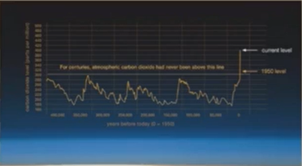
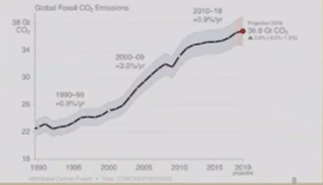
C02 EMISSIONS
Amount of C02 in the atmosphere was 280 PPM from about 10,000 years ago until the start of the Industrial Revolution. The monthly global average nosed above 400 ppm for first time in March 2015 and is now increasing at a Oster pace
Global annual temperature has increased at an average rate of 0.07•C per decade since 1880 and at an average rate of 0.17•C per decade since 1970

Slide 4
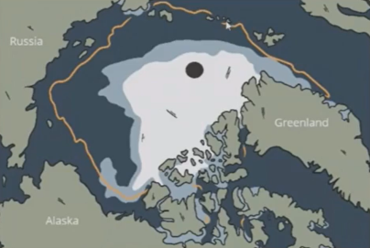
IS CLIMATE CHANGE A MAJOR THREAT?

